Slide 1


http://www.comp.nus.edu.sg/~cs2100/
Lecture #3d
Data Representation and Number Systems

Slide 2
Questions?
Ask at https://sets.netlify.app/module/66988ae3322ba68d1103fdd4
OR
Scan and ask your questions here! (May be obscured in some slides)

Slide 3
11. Real Numbers
Many applications involve computations not only on integers but also on real numbers.
How are real numbers represented in a computer system?
Due to the finite number of bits, real number are often represented in their approximate values.

Slide 4
11.1 Fixed-Point Representation
In fixed-point representation, the number of bits allocated for the whole number part and fractional part are fixed.
For example, given an 8-bit representation, 6 bits are for whole number part and 2 bits for fractional parts.
integer part
fraction part
assumed binary point
If 2s complement is used, we can represent values like:
011010.11_{2s} = 26.75₁₀
111110.11_{2s} = -000001.01₂ = -1.25₁₀

Slide 5
11.2 Floating-Point Representation (1/4)
Fixed-point representation has limited range.
Alternative: Floating point numbers allow us to represent very large or very small numbers.
Examples:
0.23 × 10²³ (very large positive number)
0.5 × 10⁻³⁷ (very small positive number)
-0.2397 × 10⁻¹⁸ (very small negative number)

Slide 6
11.2 IEEE 754 Floating-Point Rep. (2/4)
3 components: sign, exponent and mantissa (fraction)
sign
exponent
mantissa
The base (radix) is assumed to be 2.
Two formats:
Single-precision (32 bits): 1-bit sign, 8-bit exponent with bias 127 (excess-127), 23-bit mantissa
Double-precision (64 bits): 1-bit sign, 11-bit exponent with bias 1023 (excess-1023), and 52-bit mantissa
We will focus on the single-precision format
Reading
DLD pages 32 - 33
IEEE standard 754 floating point numbers: http://steve.hollasch.net/cgindex/coding/ieeefloat.html

Slide 7
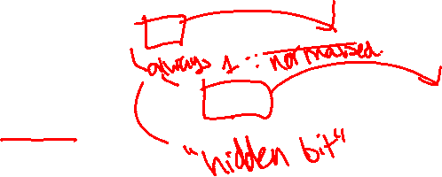
11.2 IEEE 754 Floating-Point Rep. (3/4)
3 components: sign, exponent and mantissa (fraction)
sign
exponent
mantissa
Sign bit: 0 for positive, 1 for negative.
Mantissa is normalised with an implicit leading bit 1
110.1₂ → normalised → 1.101₂ × 2² → only 101 is stored in the mantissa field
0.00101101₂ → normalised → 1.01101₂ × 2^{–3} → only 01101 is stored in the mantissa field

Slide 8


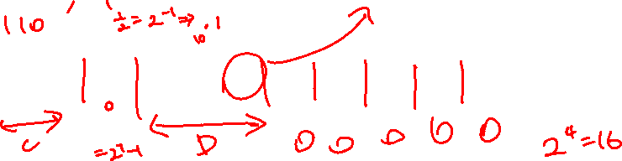
11.2 IEEE 754 Floating-Point Rep. (4/4)
Example: How is –6.5₁₀ represented in IEEE 754 single-precision floating-point format?
-6.5₁₀ = -110.1₂ = -1.101₂ × 2²
Exponent = 2 + 127 = 129 = 10000001₂
1
10000001
10100000000000000000000
sign
exponent
(excess-127)
mantissa
We may write the 32-bit representation in hexadecimal:
1 10000001 10100000000000000000000₂ = C0D00000₁₆
(Slide 4)
11000000110100000000000000000000
As an ‘int’, it is -1060110336
As an ‘float’, it is -6.5

Slide 9
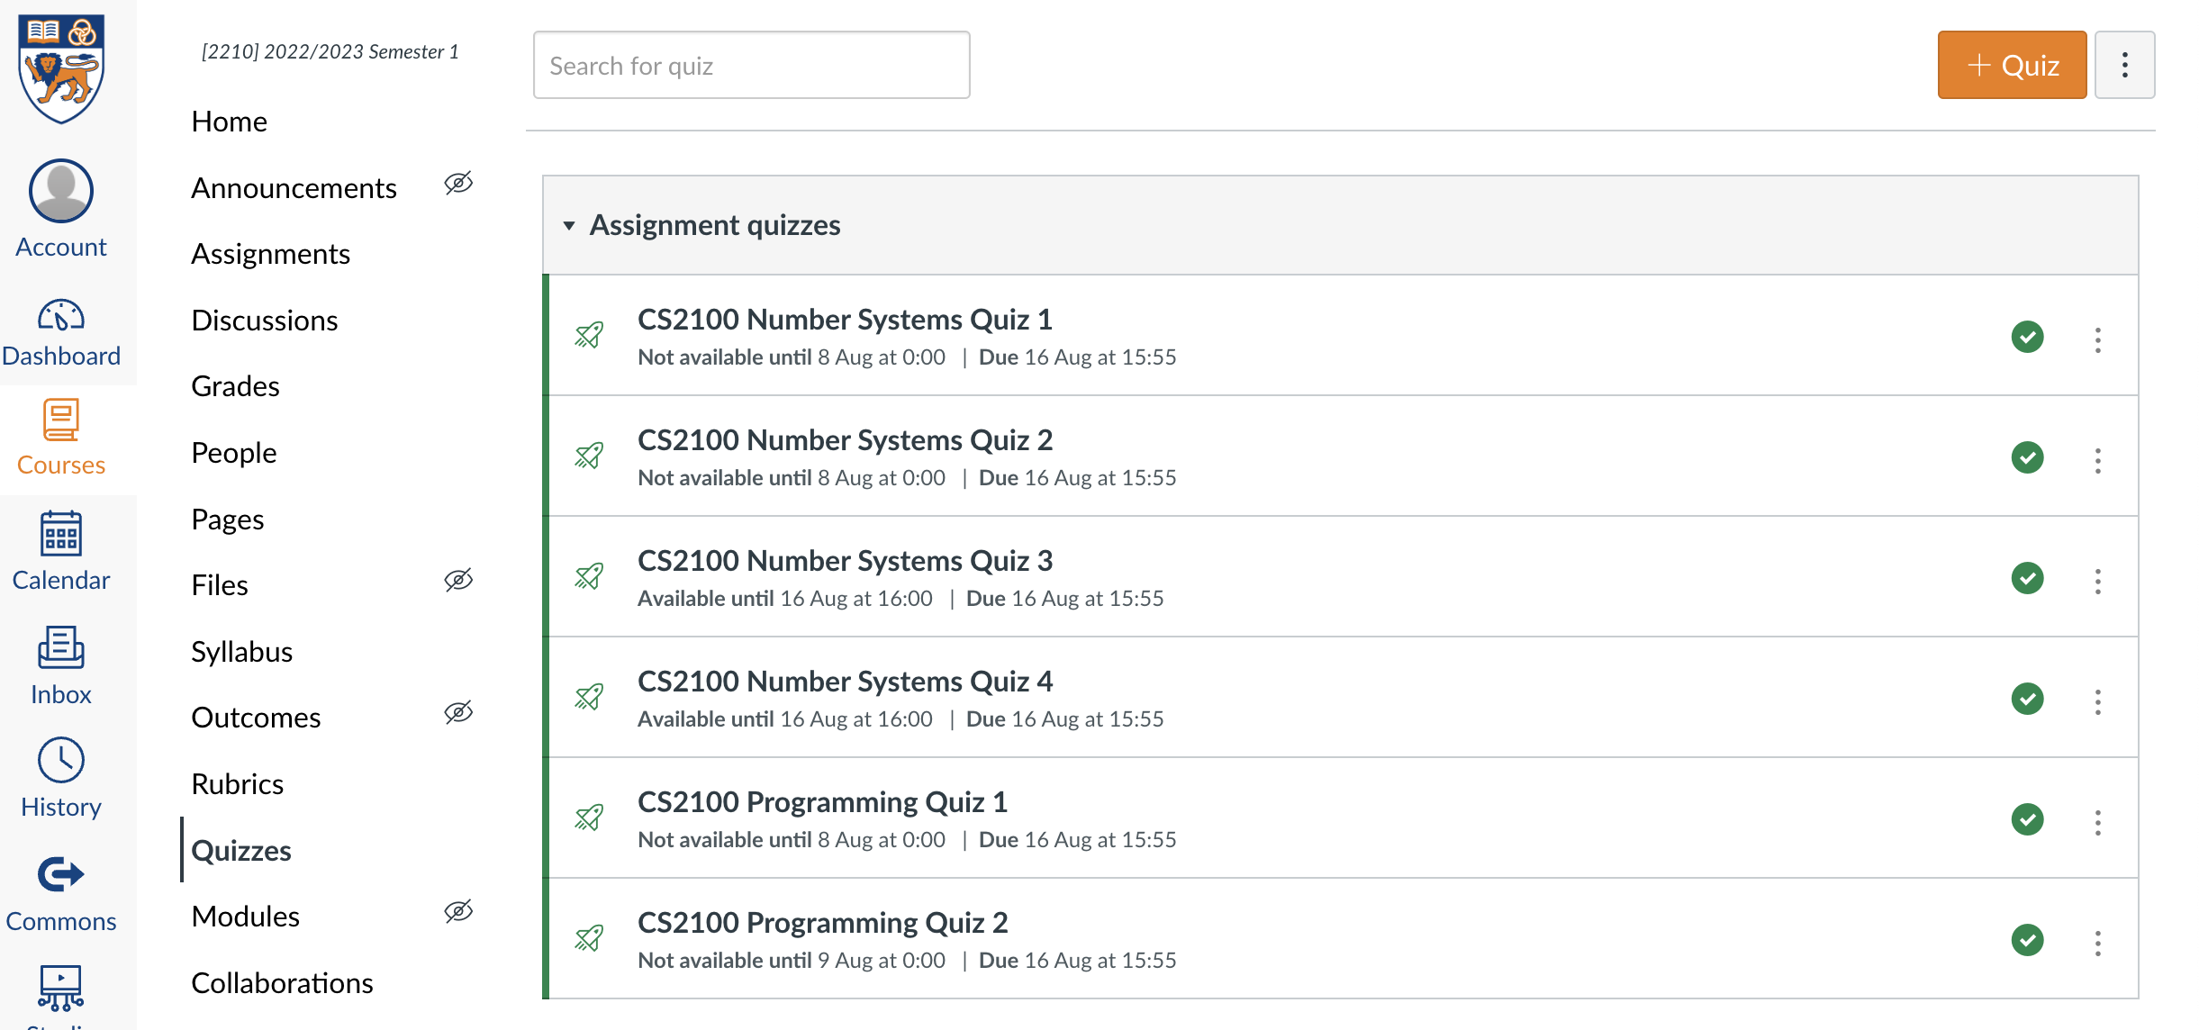
Quiz
Please complete the “CS2100 C Number Systems Quiz 4” in Canvas.
Access via the “Quizzes” tool in the left toolbar and select the quiz on the right side of the screen.

Slide 10
End of File

